Slide 1
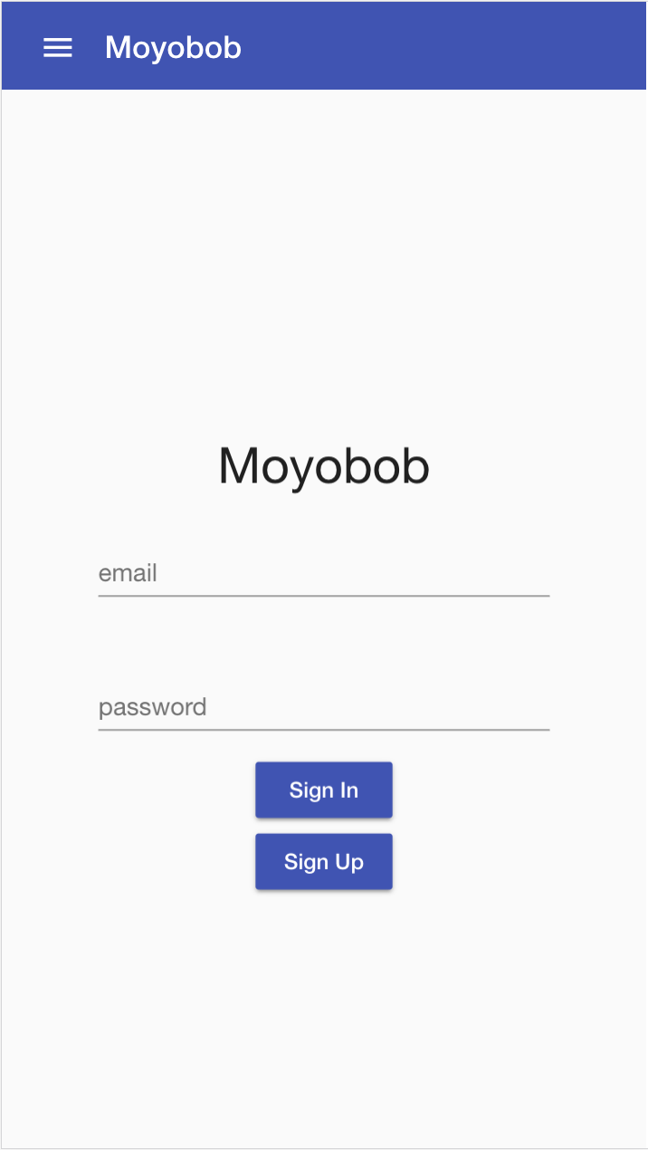
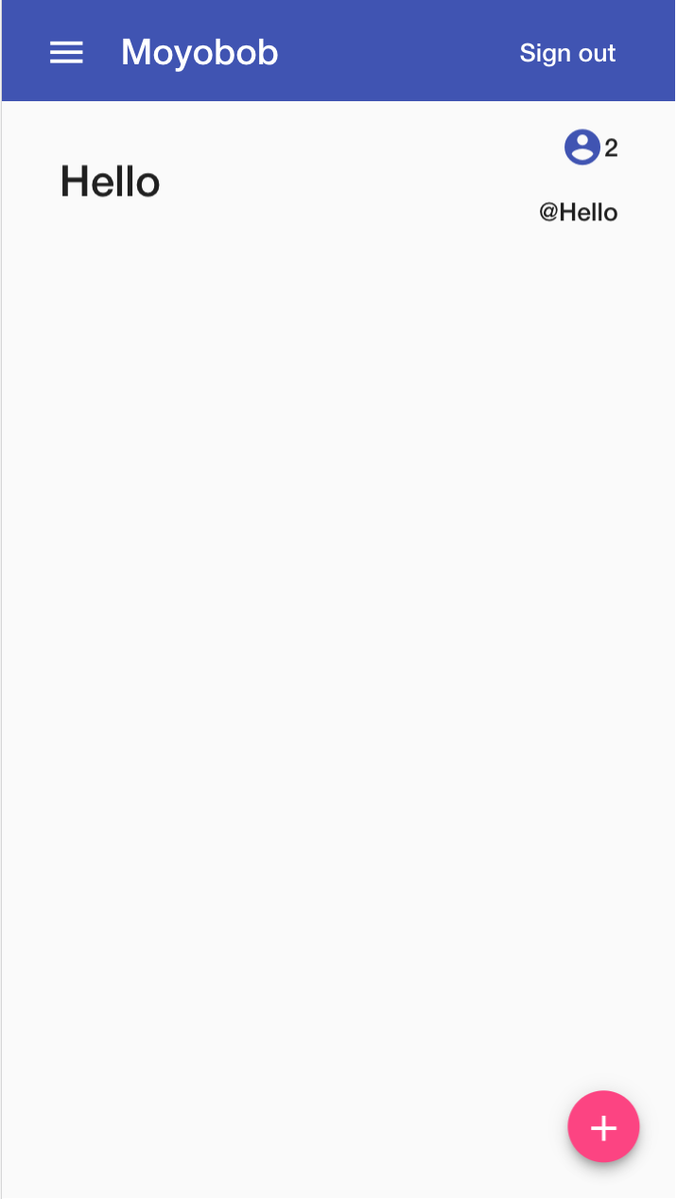
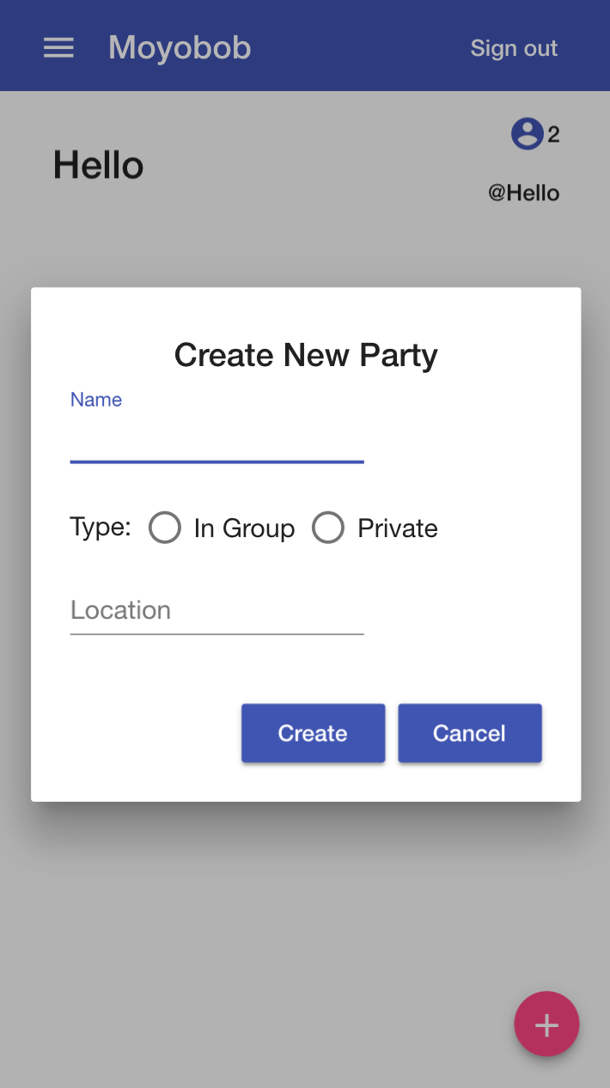
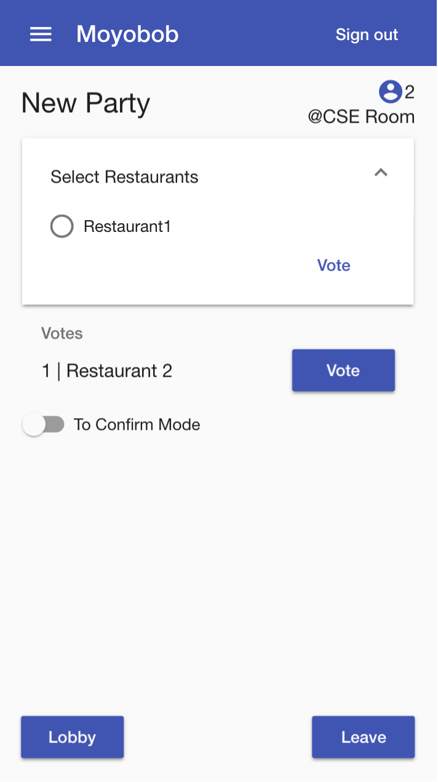
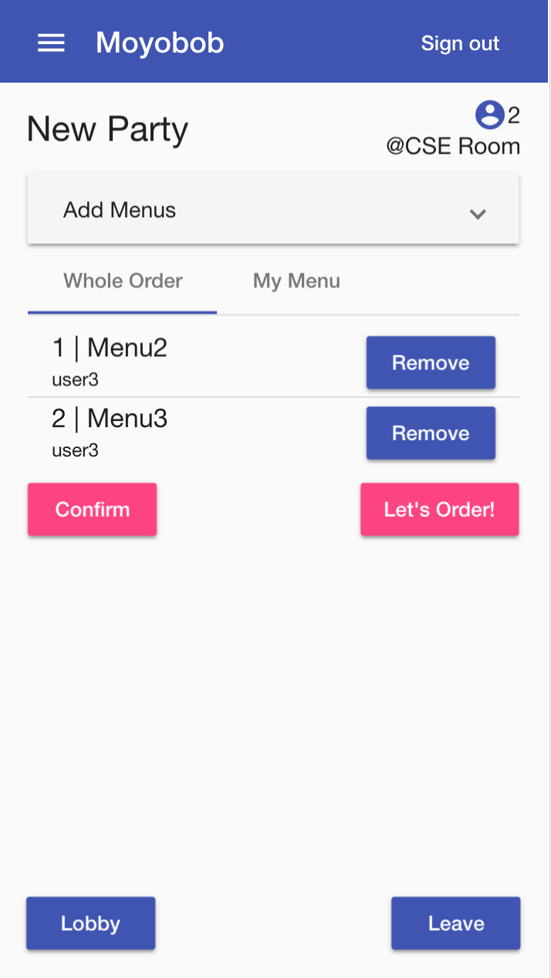
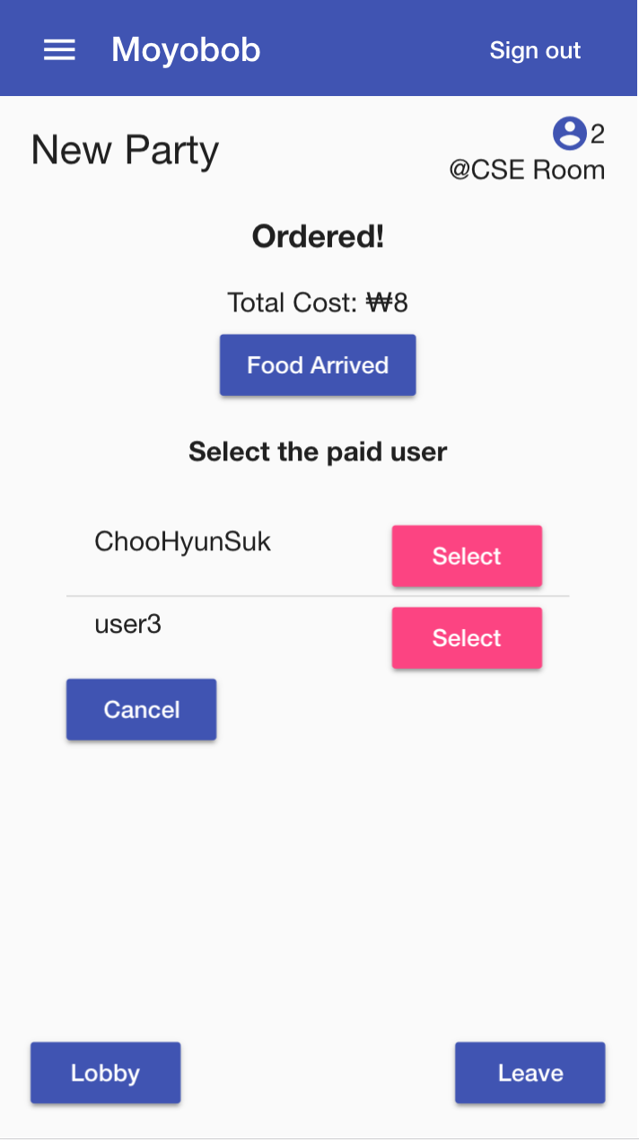
Eat Together, Moyobob!
Kim Yeonghyeon, Kim Hyemin, Lee Kangwook, Choo Hyunsuk
Introduction
Everyday in the SNU CSE club room, some problems happen repeatedly. Those are about ordering food delivery. Nearby student restaurants are not popular, so many students eat delivery food. They used to say, ‘I want somebody to develop for our mealtimes’. So we did. Moyobob will be a wonderful service for everyone who would like to eat delivery foods together.
Key Features
Organizing party Party is an unit of people who want to eat together (e.g. CSE club room supper Chinese food party). | 2. Decision making Each party has five phases: ChoosingRestaurant, ChoosingMenu, Ordering, Ordered, PaymentAndCollection. | 3. Collecting a bill User can check the list of how much to give or receive.
System Architecture
Deploy Architecture
Docker and Docker-Compose for deploying
Easy to deploy
Easy to scale (scale up with Docker Swarm)
Uvicorn for ASGI
Blazing Fast ASGI Server
Supports Websocket
Caddy for Web Server
Easy configuration
Automatic HTTPS
Dedicated domain www.moyobob.me
Full HTTPS support with Caddy
‘A’ rated by Qualys SSL Test
Easy and Fast Deployment with Docker
Docker Image is built with Docker Hub Automated Build
User Interface
Backend Architecture
Websocket with Django Channels
Cache with Redis
DB with PostgreSQL
Frontend Architecture
Websocket with rxjs
Angular’s Service-Component System
Test Coverage
Future Work
Test Tool: CircleCI & Codecov
View of the test progress by CircleCI (left) & The overall coverage metric(right)
Link with messenger like Slack and KakaoTalk
Add review of restaurant and menu feature
Improve service design
Principles and Practices of Software Development CSE, SNU

